Slide 1

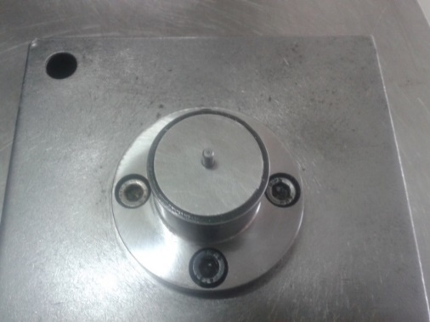
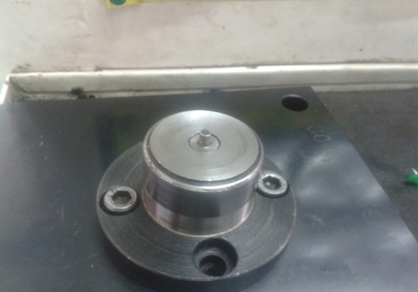
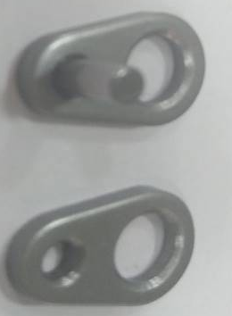
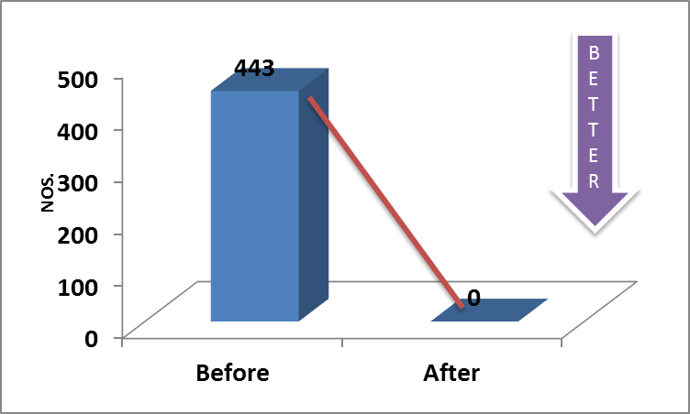
P15
TPM CIRCLE NO :- 3
ACTIVITY
KK
QM
PM
JH
SHE
OT
DM
E&T
KAIZEN IDEA SHEET
TPM CIRCLE NAME : P15 TEAM
LOSS NO. / STEP
DEPT :- Assembly
RESULT AREA
P
Q
A
C
D
S
M
B
CELL :-A394
CELL NAME:- Decomp assly
MACHINE / STAGE :- A394Assembly Line
OPERATION :- Plate pressing stage.
KAIZEN THEME : To reduce 'Inprocess rejection on A187 plate Bend
IDEA :- Fixture design needs to change by considering rigid resting
COUNTERMEASURE:- Fixture design changed instead of 6mm area of resting increased to cover whole length of component
BENCHMARK
443 No.
WIDELY/DEEPLY:-
TARGET
0 No.
KAIZEN START
01.08.2016
PROBLEM / PRESENT STATUS :-Plate bending during pin pressing
KAIZEN FINISH
22.08.2016
TEAM MEMBERS :-
Samadhan ,nitin ,Sandip Patil
Sunil Kinkar Sir
BENEFITS :-
Prevent Re-occurrence of Customer Complaint.
Reduce COPQ.
KAIZEN SUSTENANCE
BEFORE
AFTER
WHAT TO DO: Verification of fixture
HOW TO DO: Visually
FREQUENCY : Daily
WHY - WHY ANALYSIS :-
Why1: Plate bend while pin pressing
Why 2: plate getting tilt while pressing
Why 3: Inadequate area for resting
Why 4: Wrong fixture design.
RESULT :-
SCOPE & PLAN FOR HORIZONTAL DEPLOYMENT
Sr No | CELL | TDC | RESP. | STATUS
1 | -
ROOT CAUSE :- Wrong fixture design.
REGISTRATION NO. & DATE: 01.08.2016
REGISTERED BY :- Samadhan bankar
MANAGER’S SIGN :-janardan sate

